Slide 1


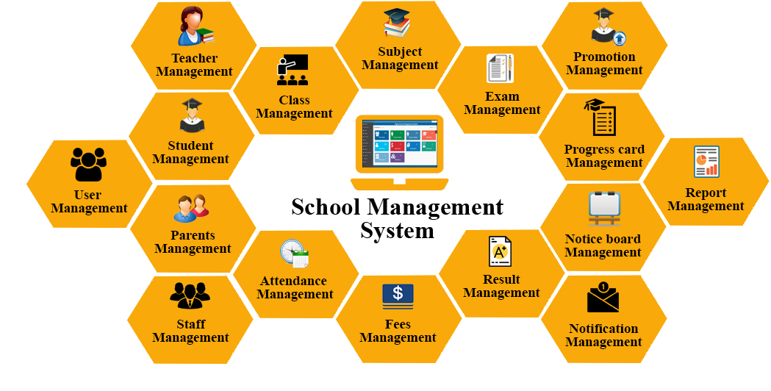

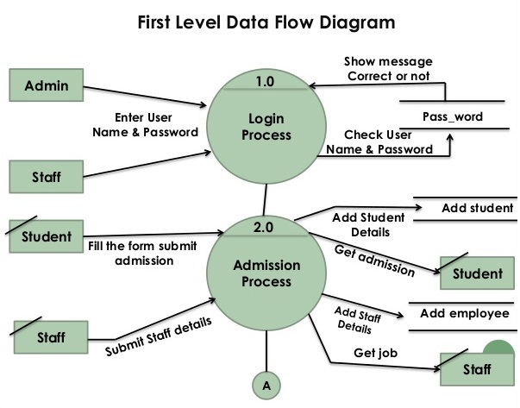
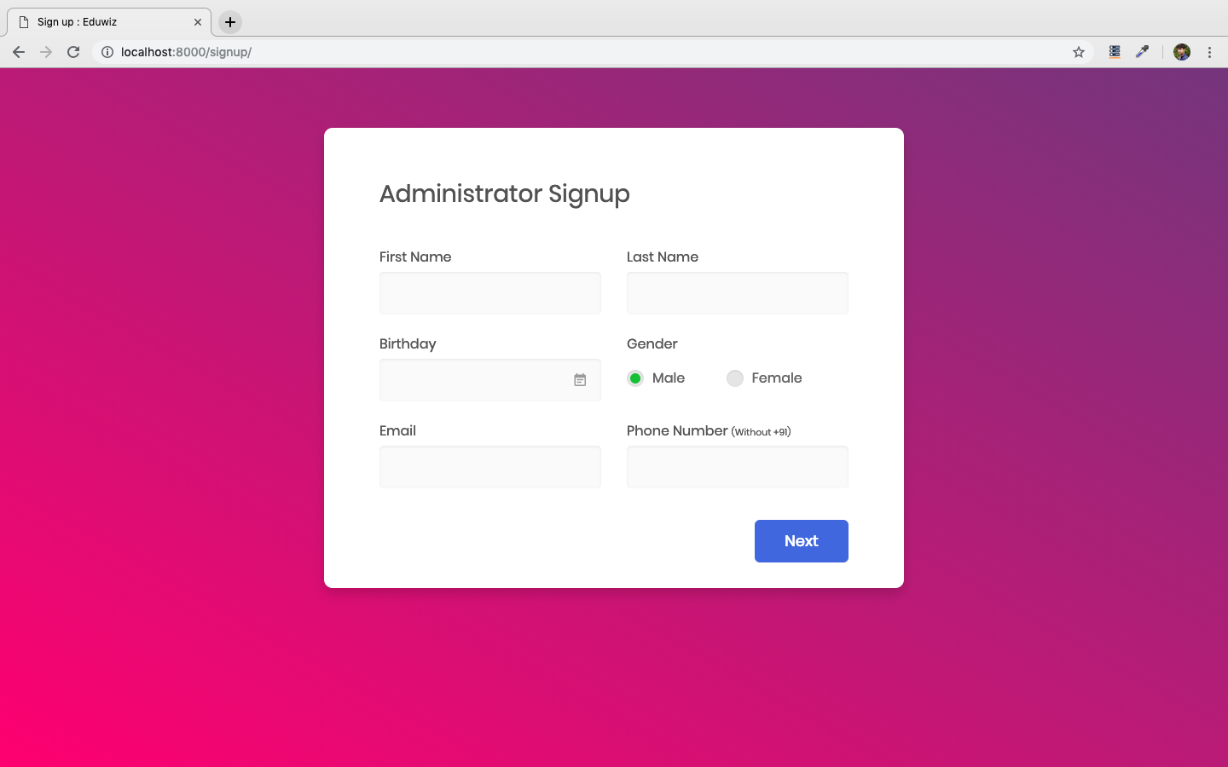
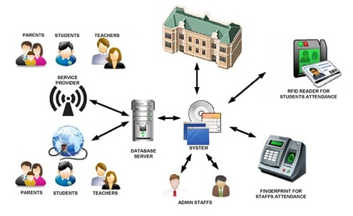
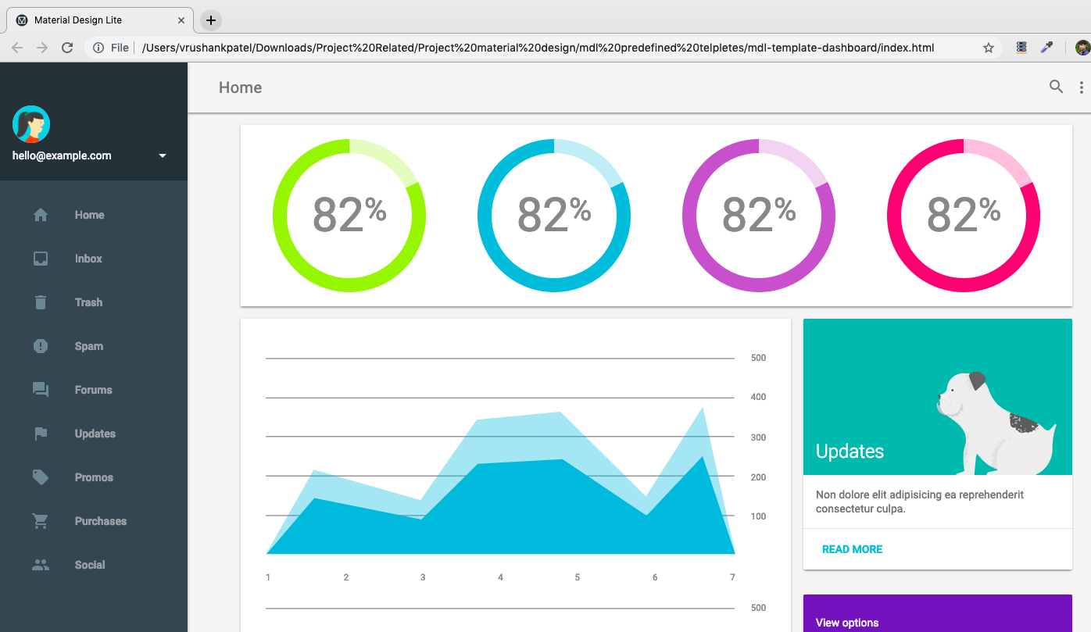
Eduwiz
Prepared By: H.O.D Guided By
Vrushank A. Patel Prof. Sanket Raval Prof. Sanket Raval
151280116042 Asst. Professor Asst. Professor
abstract
Project Eduwiz is the School management based project comes with all new features like Student management, Dashboards, Reports, Analytics, Database security, Data backup, Email and SMS Integration etc. The educational management System is a typical information management system, including the establishment and maintenance of database and the development of front stage application program. It requires a database of data consistency and integrity to build strong, full and good, and for the latter procedure, it requires full-functioned and easy to use and so on. The main objective of the Management System is to manage the details of Schools, Students, Classes, Teachers, Registrations.
Introduction
Work flow of the system
Implementation RESULTS
I am going create an application that will minimize all paper meets expectations and to keep the documents of the understudies and in the meantime the vital papers of the school a system that completely automated, easy to use, time successful and proficient. In huge amount of schools and specially in government schools, I’ve seen the only thing on which they store and retrieve the information or data, and that is bunch of papers and files. It is really too complicated to manage the academic data from files and bunches of papers.
BOOKS REFERED
Formal Engineering
Applied Datastructures and Algorithms
Head first Software Design Patterns
Programming Pearls
2. WEBSITES REFERED
Medium.freecodecamp.org
techdevguide.withgoogle.com
Vectr.com
LITERATURE SURVEY
Fig.1 Existing System
Fig.3 Eduwiz home
references
Fekara School and student management system https://fekara.com/school-software/
Trymyschool web school ERP
https://www.trymyschool.com/features/information-management-system
Drive your school with penpencileraser https://www.penpencileraser.com/what-is-penpencil-eraser.php
Web School ERP: School management system https://web-school.in/about-us/
Fig.4 Registration Panel
PROPOSED system
The proposed system has functionality which can make it ease for school admin, teachers, students and their parents. The Eduwiz will first register administrator into our system with taking all the required information. The visitor[student or parents] can search and contact school for further information and queries. The Dashboard account will automatically created when admin account will created. Dashboard will provide different information among different users. For ex. For any parents their student account dashboard will give only that student’s information graphs and result information. But the admin dashboard will show allover number of students per class and standard, allover fees collection charts, allover students result and performance, students attendance graph, teacher’s attendance etc. Students results will also reflected on their account on eduwiz which will be accessible by their respective parents. Student account dashboards are specially designed to reflect the student’s status in school like results, activity console etc. Complaint registration forms are currently under development but they will be ready in some couple of days.
Fig.5 Dashboard Panel
Fig.2 System Work Flow
conclusions
Modules of Proposed system
At the end of the system we can say that this system will provide a single platform where Students, teachers, parents and school admin can organize their work easily.
User will not only have web application but also android application which is under development.
It will save time of user as will find everything in a single place.
The modules in the existing systems are:
Administrator
Clerk
Students
Teachers
Parents
Single platform for everything.
Trustworthiness of everything.
Knowledge of local events and schedules around the area.
Information of activities and timings through platform of Institutes.
Advantage of the system
Acknowledgement
We are thankful to our Head and guide Mr, Sanket Raval for there guidance, support and suggestions in during the project work.
We are thankful to our friends for their suggestion during this work.
Department of Information Technology

